Slide 1
Final Presentation: Team TBD
Zach Madison, Solomon Preston, Alex Peters, Adonis Lattimore, Joshua Sykes

Slide 2

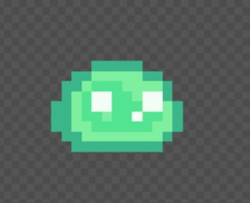
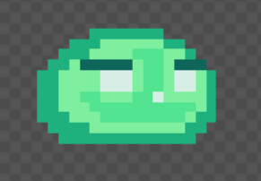
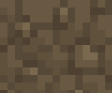
Slime Iterations

Slide 3
Animations
Walk
Dash
Jump

Slide 4


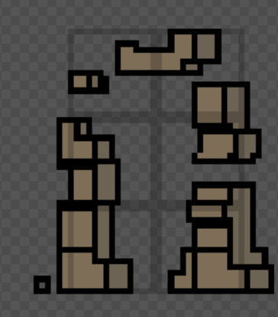
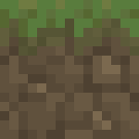

Terrain Textures

Slide 5
SDLC
Used incremental SDLC
Weekly Cycles
Documentation/Planning
Diagramming
Implementation
Security/Testing + Organization

Slide 6
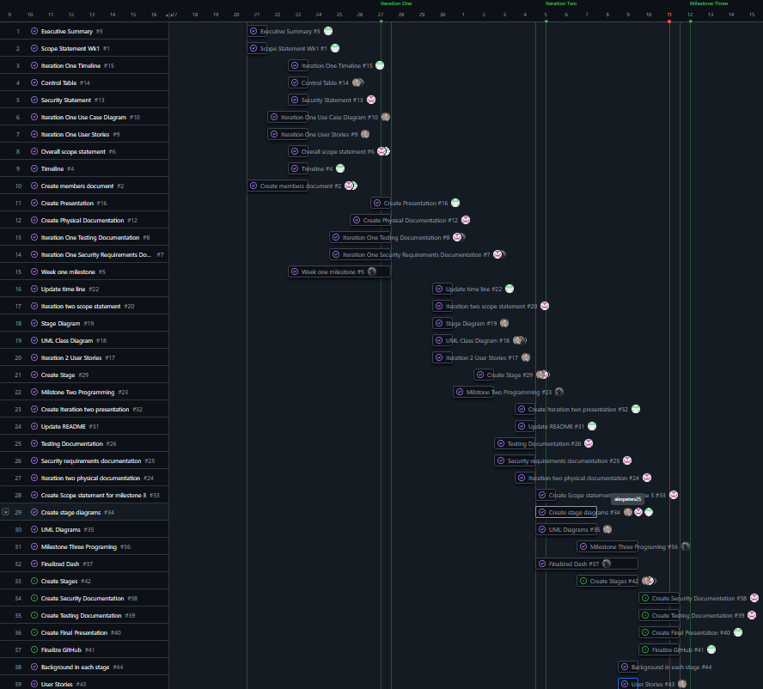
Timeline

Slide 7
Goals
Main Goal:
Create a simple 2D platformer
Other Goals:
Movement:
Simple left, right, and jump
Simple dash for quick burst movement
Animated player character:
Create an animated slime character for the player to control
Stages:
Create five stages for the user to play

Slide 8
Challenges
Learning Unity
New environment for all group members
Schedule Conflicts
Incremental SDLC exacerbated schedule conflicts

Slide 9
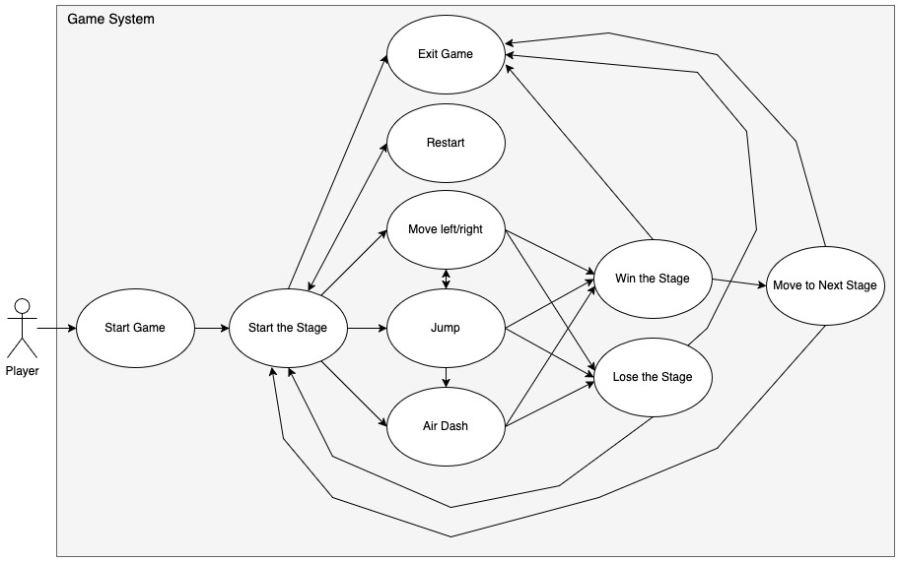
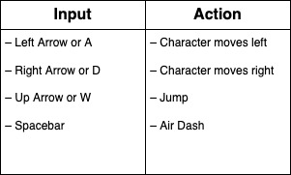
Diagrams
Use Case & Control Table

Slide 10
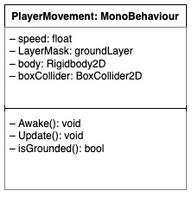
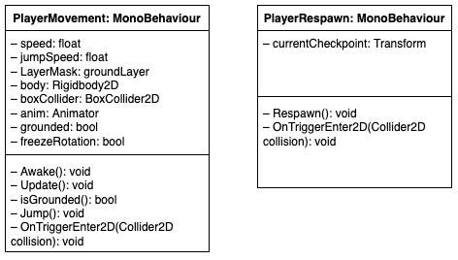
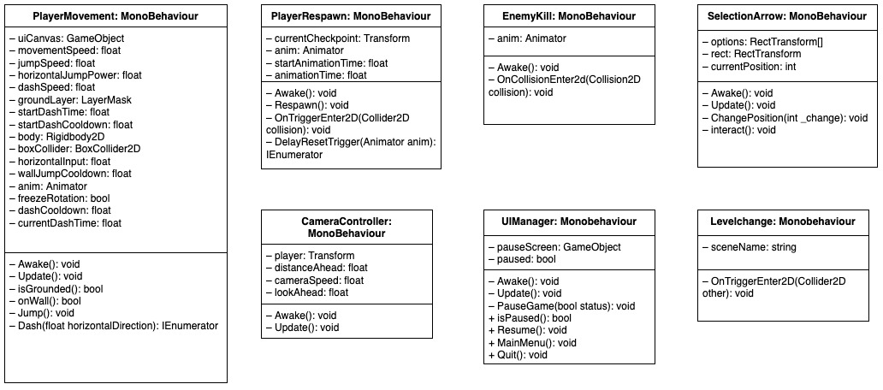
Diagrams
Iteration 1
UML Class Diagrams
Iteration 2
Iteration 3

Slide 11
Stages
Created Five Stages
Each stage of increasing difficulty
Process:
Stages diagramed prior to creation
Stages then created in Unity using built in tile-map features

Slide 12
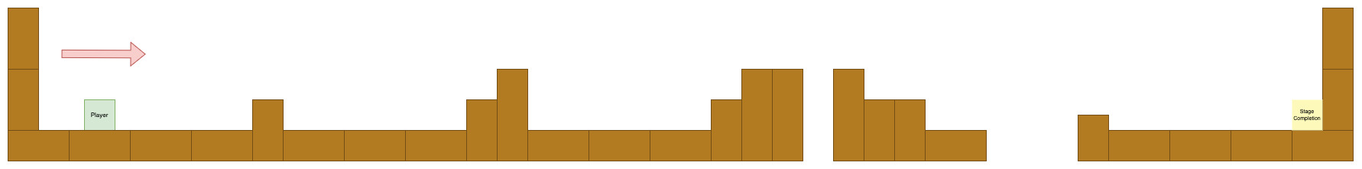
Stage 1
Designed By Alex Peters

Slide 13
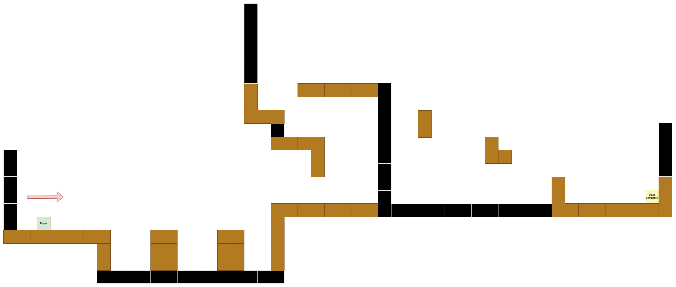
Stage 2
Designed By Alex Peters

Slide 14
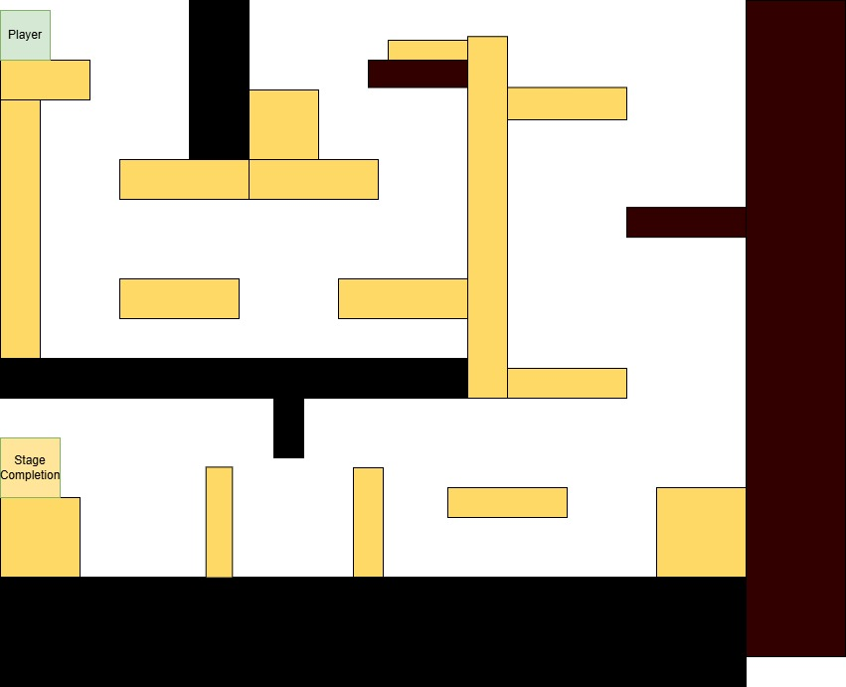
Stage 3
Designed By Addonis Lattimore

Slide 15
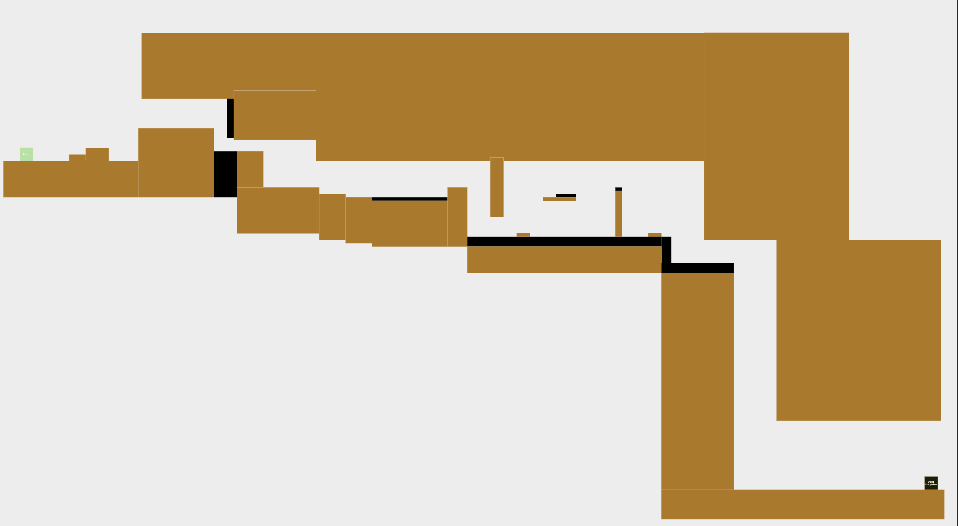
Stage 4
Designed By Zach Madison

Slide 16
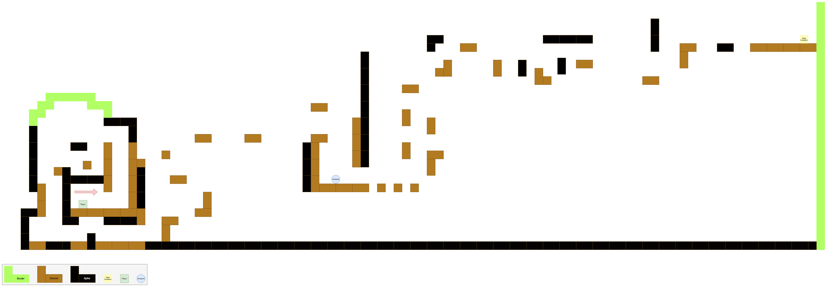
Stage 5
Designed By Alex Peters

Slide 17
Security/Documentation
Every iteration of the game was tested and documented
Movement, stage collision, dashing, wall jumping, and spike collision were tested

Slide 18
Code/Demonstration

